Slide 1

A LOOK AT THE VALUATION OF G12 FX Behavioral Equilibrium Exchange Rate Models
Hans Heytens
hansheytens@hotmail.com
0032 469 19 22 26
Thomas Dierckx

Slide 2
HYPERLINK TO PYTHON CODE

Slide 3
GOAL OF THIS PROJECT
Use Python for long-term FX-valuation modelling.
Construct a long-term equilibrium fair value model to value G12 FX Currency Pairs: G9 + 3 CEE-currencies: eurusd, usdcad, usdjpy, gbpusd, usdsek, usdnok, usdchf, audusd, nzdusd, usdpln, usdhuf, usdczk. Run in-sample and out-of-sample Fixed Effect Panel Regressions. Determine currencies with largest deviations in valuation.
Construct an Error Correction Model to estimate the impact of valuation misalignment on future movements in the actual exchange rate.
Machine learning (random forect,….?)
Construct a macro trading model that takes long-term positions in currencies only if the currency misalignment versus the fair value estimate is extreme.
PYTHON PROCESS
Import data. Preprocess variables (cleaning, resampling, missing values,…). Construct panel data.
Data visualization/Exploration: plot variables, plot scatterplots,…
Construct user-defined functions to be used in the Notebook
Perform statistical tests: stationary-tests, adf, plot acf, time-lagged cross correlations, Engle-Granger for cointegration
Run and fit regression models
Fixed Effect panel regression: in-sample and out-of-sample through expanding window fixed effect panel regression
Vector Error Correction model
Run machine learning models:
Random Forest
Visualize long-term equilibrium fair-values for each currency: plot actual level, fair-value in sample, fair-value out of sample,…
Construct systematic trading model. Run performance statistics.

Slide 4
MOTIVATION
We publish our work and learning process because of the protégé effect. Explaining or showing a process to others is the best way to learn for ourselves. We encourage all readers to check our code, logic and search for any pitfalls/errors/mistakes.
INTENDED USE
The code in the notebook is for illustrative and education purposes only.
The logic and/or python code might contain errors. All mistakes remain the author's fault. If you find any, let us know so we can rectify.
LIMITATIONS AND FUTURE CHALLENGES OF THIS PROJECT
Include other independent variables: political uncertainty index, expected policy rates, fiscal indicators, solvency indicators, liquidity indicators,…
CREDITS
Two papers on exchange rate modelling from investment banks gave us the idea to implement a BEER-model in python ourselves. These papers are:
‘Introducing BEER by UniCredit, a framework for modelling exchange rates’, 3 Sep 2018, UniCredit
‘Merging GSDEER and GSDEEMER:A Global Approach to Equilibrium Exchange Rate Modelling’, May 2005, Goldman Sachs

Slide 5
INTRODUCTION
Determining long-term fair values of exchange rates ➔ academic literature distinguishes between:
FEER – Fundamental Equilibrium Exchange Rate Models:
Fair value of fx = value that will bring current account equal to a sustainable capital account (full employment)
BEER – Behavioral Equilibrium Exchange Rate Models (Clark and Macdonald, 1988):
Fair value of fx is estimated through econometric regression. The regression equation is often based on macroeconomic variables that are logic and make economic sense. Important, as this is considered a long-term model the variables should affect the exchange rate in the long run.
Benefits compared to FEER include:
Direct empirical analysis of the long-term currency drivers.
Direct view on magnitude of importance and significance.
Timely: economic indicators available at higher frequencies possible.
x steps in the econometric analysis:
Step 1:
Run a fixed effect panel regression (in-sample) of the exchange rate versus selected macroeconomic variables.
Determine the magnitude and statistically significance of each macroeconomic variable.
Calculate fair values (fitted in sample) with the estimated regression coefficients.
Step 2:
Determine if deviations from fair value (fitted regression values) are economically and statistically meaningful. Do large deviations from fair value imply that the exchange rate will revert again to fair value in the future?
This is done through an error correction model. The estimated coefficient should be negative (indicating mean-reversion) and significant.
Step 3: out of sample, recursive panel regression?
Step 4: Machine learning model?
Step 5: trading model?

Slide 6
DATA: SAMPLE OBSERVATIONS, RESPONSE VARIABLE AND INDEPENDENT VARIABLES
Sample Periods per currency/country
RESPONSE/DEPENDENT/TARGET:
Log of the exchange rate. Exchange rate is of format domestic/dollar. Base currency is the domestic country, quoted currency is dollar. Number of units of dollars to one unit of the domestic currency.
Rise in the exchange rate is a rise in the domestic currency versus the dollar.
Data is from Bloomberg.
5 FEATURES/INDEPENDENTS/REGRESSORS/EXPLANATORY VARIABLES
Log of the relative terms of trade. Terms of trade is ratio of export prices to import prices. The relative terms of trade is calculated as ratio of domestic terms of trade to terms of trade of the USA. Terms of trade captures developments in prices of export and import goods. Generally, a rise in the terms of trade would be supportive of a currency as importers demand less foreign FX and foreign demand for domestic currency increases to cover higher export prices. Data is from Citigroup.
Log of relative gross fixed capital formation as % of GDP. Gross fixed capital is a measure for investment appetite in a country. Higher levels should indicate more investment opportunities. On average, this could be supportive of the currency if some of the investments are financed by foreign demand. Data is from IMF.
Yield differential: 10y government yield domestic country minus 10y government yield USA. On average, higher yield differentials should be supportive for the currency with the positive differential. Data is from Bloomberg and IMF.
Log of the relative CPI-index. The inflation differential is a measure of competitiveness. Countries with open economies and lower inflation differentials have cheaper goods and services. On average, this would be supportive of the currency. Data is from IMF.
Log of relative productivity. Balassa-Samuelson effect is the effect where regions with high productivity experience support in their real exchange rates. Productivity here is the labor productivity index as a ratio to the labor productivity in the USA. Data is from OECD.
All currencies that do not quote in terms of dollars, were converted to the form domesticusd.
Data for some currencies was only available at quarterly basis. In these cases, we linearly interpolated to monthly values.
Macroeconomic data was shifted to create a lag to make the series point in time. This made sure the data was available at the dates corresponding to the currency closing prices.

Slide 7
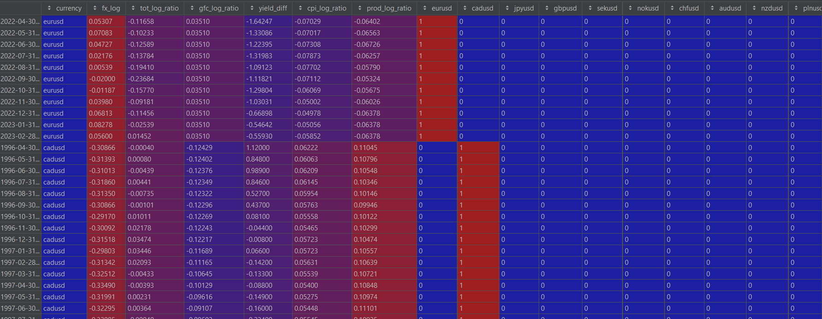
DATA: SAMPLE OBSERVATIONS, RESPONSE VARIABLE AND INDEPENDENT VARIABLES
Snapshot of our panel data: 3705 monthly observations, 5 features and 12 country/fx dummies.

Slide 8
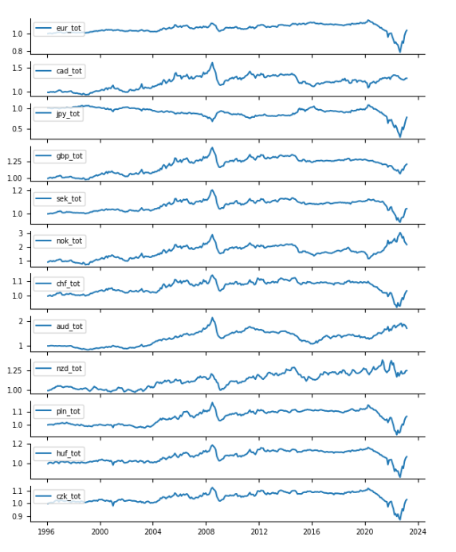
DATA EXPLORATION – relative terms of trade
DATA EXPLORATION – Relative Terms of Trade versus United States
Some remarks:
The start of Covid in 2020 together with the commodity bull run led to sudden deterioration in relative tot versus USA for most countries except for some commodity currencies such as: CAD, NOK, AUD & NZD.
The Bloomberg commodity index peaked around May 2022. Since Sep 2022 we notice strong improvement in relative terms of trade versus the USA for most countries since Sep 2022, except for Norway & Australia.

Slide 9
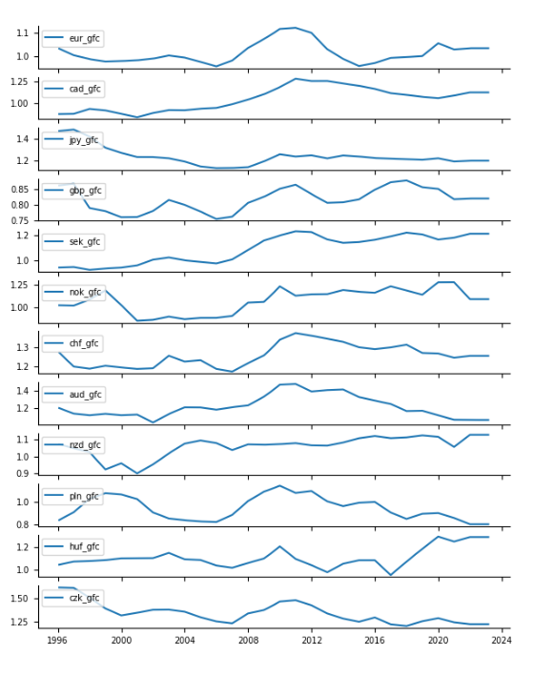
DATA EXPLORATION – relative gross fixed capital as % of GDP
Some remarks:
Improving versus USA last couple of years:
Sweden, New-Zealand, Hungary
Worsening versus USA last couple of years:
UK, Australia, Poland
Stable versus USA last couple of years:
Euro area, Japan

Slide 10
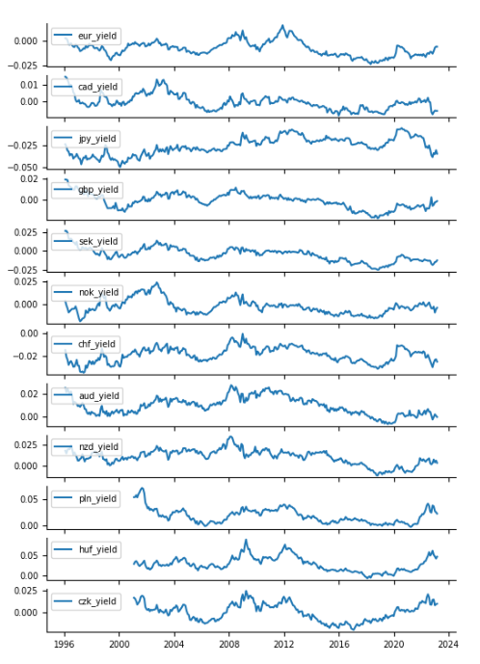
DATA EXPLORATION – 10y yield differential
Some remarks:
Upward trending yield differentials with USA:
Euro area, UK
Downward trending yield differentials with USA
Canada, Japan Sweden, Switzerland, Australia
Seem to be at turning point:
CEE3 FX: Poland, Hungary, Czech

Slide 11
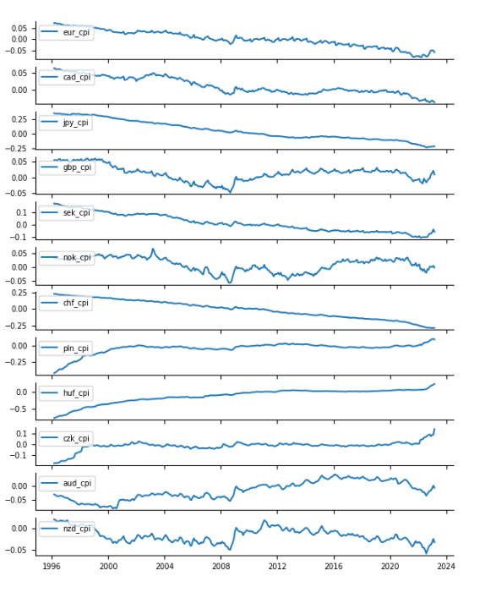
DATA EXPLORATION – relative CPI-index
Some remarks:
EUR: relative cpi index long term downtrend versus US, recently: upticks
Currency pairs with structural downtrends in relative CPI index versus USA which could lead to more structural competitiveness versus USA and structural support for the domestic currency in the long run:
Euro Area, Canada, Japan, Sweden (except lately strong upticks), Switzerland
Structural long-term inflators versus USA
Poland, Hungary, Czech

Slide 12
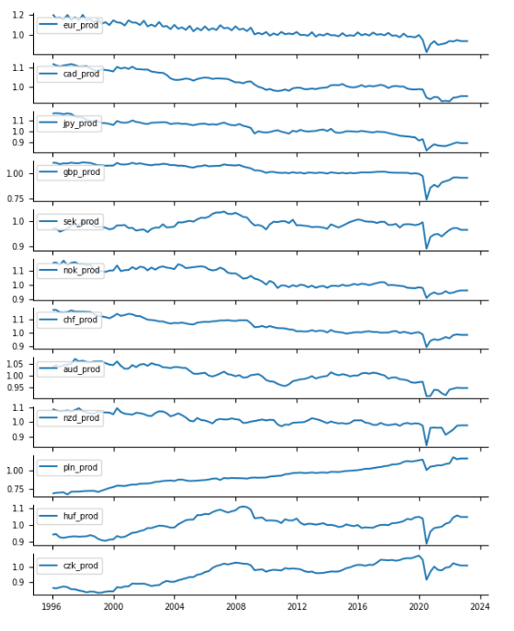
DATA EXPLORATION – relative productivity index (Balassa-Samuelson)
Some remarks:
Long-term structural downward trends in relative productivity versus USA:
Euro area, Canada, Japan, Norway, Switzerland, Australia,
Hence the word: KING DOLLAR
Structural upward trends:
Poland

Slide 13
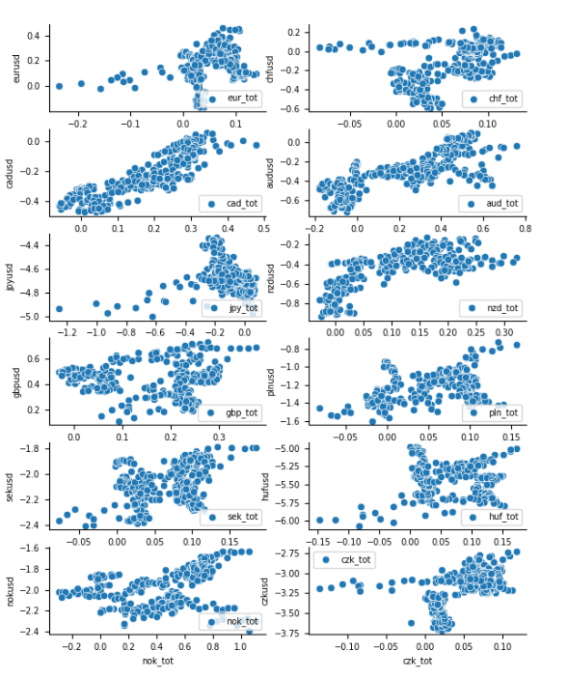
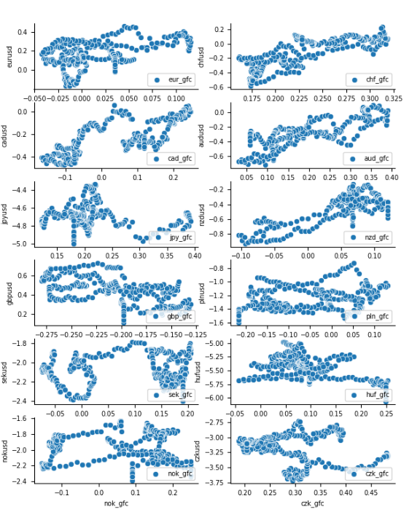
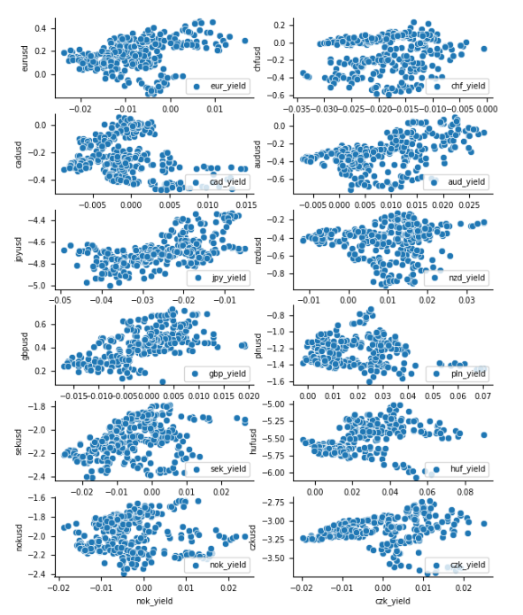
DATA EXPLORATION – scatter plots
Log(fx) versus log(relative terms of trade)
for 12 currencies
(should notice positive correlation on average)
Log(fx) versus log(relative gross fixed capital % gdp)
for 12 currencies
(should notice positive correlation on average)
Log(fx) versus 10y yield differential
for 12 currencies
(should notice positive correlation on average)

Slide 14
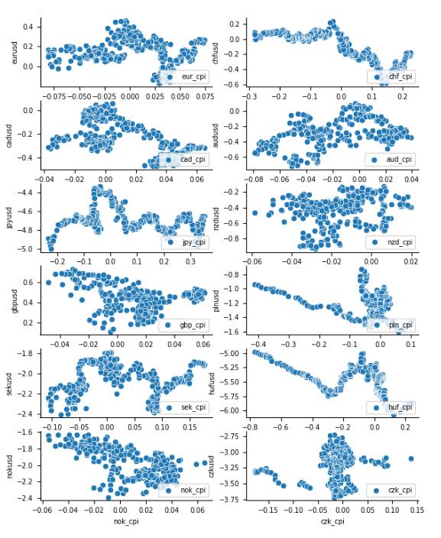
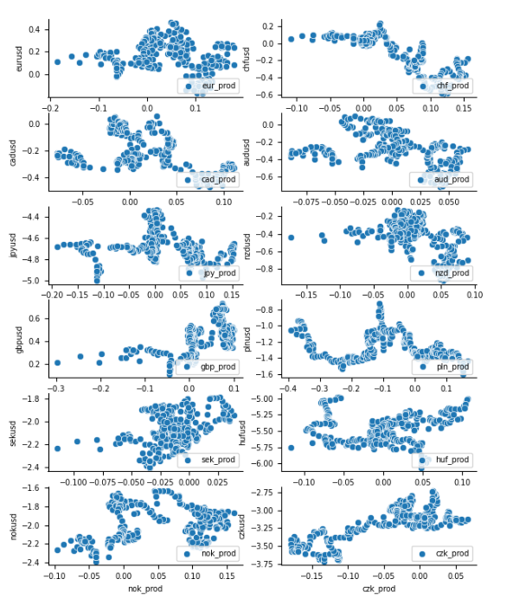
DATA EXPLORATION – scatter plots
Log(fx) versus log(relative CPI-index)
for 12 currencies
(should notice negative correlation on average)
Log(fx) versus log(relative productivity-index)
for 12 currencies
(should notice positive correlation on average)

Slide 15
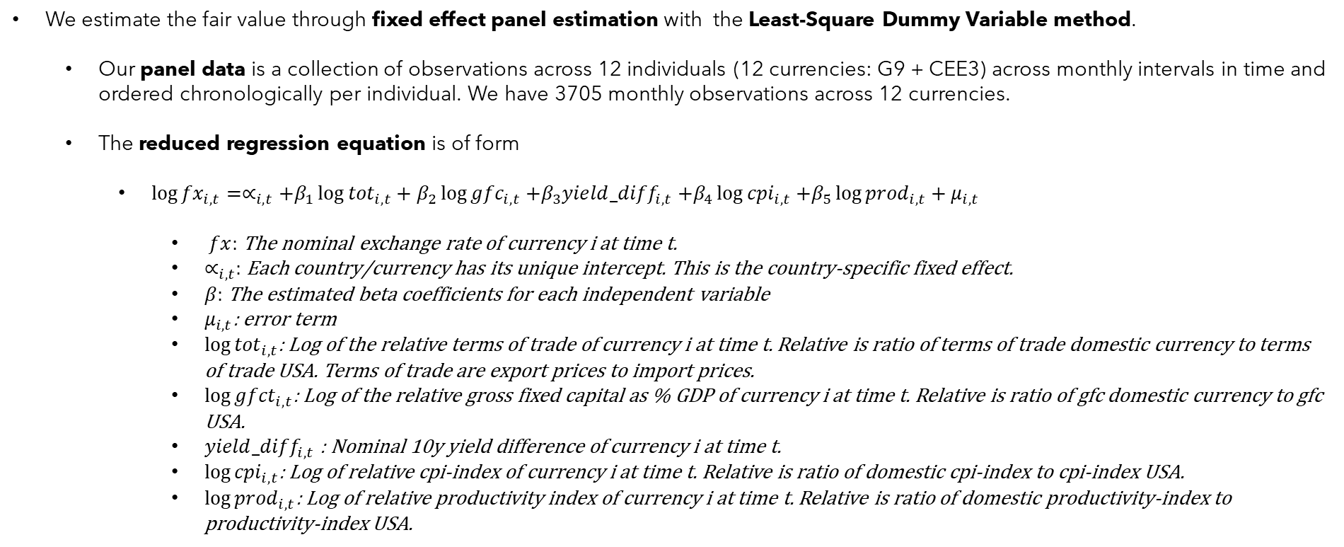
STEP 1 – Run Fixed Effect Panel Regression in-sample
We estimate the fair value through fixed effect panel estimation with the Least-Square Dummy Variable method.
Our panel data is a collection of observations across 12 individuals (12 currencies: G9 + CEE3) across monthly intervals in time and ordered chronologically per individual. We have 3705 monthly observations across 12 currencies.
The reduced regression equation is of form
$\log{{fx}_{i,t}}=∝_{i,t}+β_{1}\log{{tot}_{i,t}+β_{2}\log{{gfc}_{i,t}}}$ $+β_{3}{yield_diff}_{i,t}$ $+β_{4}\log{{cpi}_{i,t}}$ $+β_{5}\log{{prod}_{i,t}}+μ_{i,t}$
$fx:$ The nominal exchange rate of currency i at time t.
$∝_{i,t}:$ Each country/currency has its unique intercept. This is the country-specific fixed effect.
$β:$ The estimated beta coefficients for each independent variable
$μ_{i,t}$: error term
$\log{{tot}_{i,t}}$: Log of the relative terms of trade of currency i at time t. Relative is ratio of terms of trade domestic currency to terms of trade USA. Terms of trade are export prices to import prices.
$\log{{gfct}_{i,t}}$: Log of the relative gross fixed capital as % GDP of currency i at time t. Relative is ratio of gfc domestic currency to gfc USA.
${yield_diff}_{i,t}$ : Nominal 10y yield difference of currency i at time t.
$\log{{cpi}_{i,t}}$: Log of relative cpi-index of currency i at time t. Relative is ratio of domestic cpi-index to cpi-index USA.
$\log{{prod}_{i,t}}$: Log of relative productivity index of currency i at time t. Relative is ratio of domestic productivity-index to productivity-index USA.

Slide 16
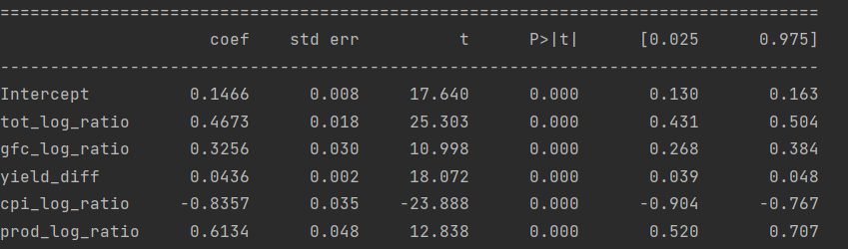
STEP 1 – Run Fixed Effect Panel Regression in-sample
Upper intercept is intercept for dummy that was left out being eurusd. There are other intercepts not shown here for each country (these intercepts are equal to euro area intercept + intercept currency)

Slide 17
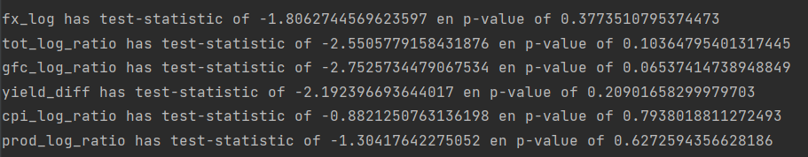
STEP 1 – Run Fixed Effect Panel Regression in-sample, statistics
Unit root test (non-stationary)
Ordinary Least Square regression can lead to spurious results if variables are non-stationary and have a unit root process. Visually we could already notice trends, cycles and varying variance in our variables. So, we already suspect unit roots as is mostly the case anyway with financial time series.
We also run Augmented Dickey-Fuller tests on all our variables for every currency. We mostly find unit root processes: high p-values indicate we fail to reject the null of a unit root in the series. The time series are indeed nonstationary. Example below of adf-test on the variables of the Euro Area.
Test for cointegration
Given non-stationary variables, our panel regression will only give valid estimates of fair value if the variables are co-integrated. Cointegration means that a linear combination of the variables are stationary, despite the variables being non-stationary. In that case, our variables share a common, hidden stochastic trend that pulls on the variables in the long run. This means, that our variables can’t deviate too much for too long from the equilibrium trend: any errors (deviations) between actual values and equilibrium fair values revert to a mean in he long run.
We follow Engle-Granger and test if our estimated residuals are stationary (which would imply mean reversion in deviations and hence cointegration of our variables). Adf-tests on the residuals gives a p-value < 0.01. We reject the null of a unit root process in our residuals. Hence, we consider our variables as co-integrated indeed and we proceed with ols-regression to estimate long-term coefficients that will determine the long-run fair value of the currencies.

Slide 18
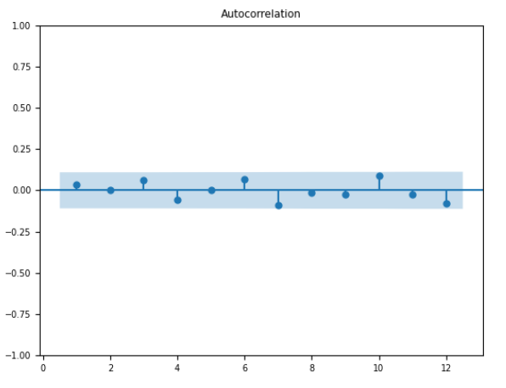
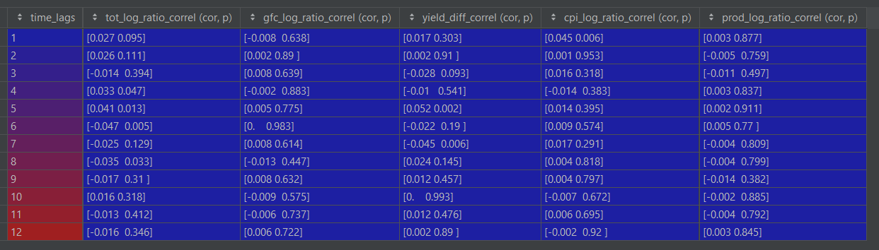
STEP 3 – Vector Error Correction Model
STEP 2 IN-SAMPLE FIXED EFFECT PANEL REGRESSION, STATISTICS
Estimating the long-run equilibrium fair-value is just the first step. We want to know if deviations from fair-value, lead to future movements in the actual exchange rate that correct the misalignment. This can be testes through an error correction model. The deviations from fair-value are the residuals from our fixed effect panel regression. The residual is defined as: actual value – predicted (fitted) value.
The Vector Error Correction model is a panel regression where the change in the exchange rates at time t (first difference in log fx) is regressed on
The residuals at time t-1 (lagged residuals): the deviation from fair value at previous period.
Control variables such as:
Time lagged changes in the response variable itself.
Time lagged changes in the independent variables.
We don’t include lagged response differences (difference of log fx) in our variables. We tested autocorrelation on each currency for stationary log fx (first difference of log fx) and found it to be nihil. See example below on EURUSD.
Do we have to include lagged values of differenced features? We test for time lagged cross correlations between the differenced log exchange rate and lagged differences in our independent variables. The p-values are of interest to us. We find high p-values (we are looking at 1% significance levels) indicating no time-lagged cross correlations. There is one exception: the 6-period time lag for difference log terms of trade appears to be significantly correlated with current difference in the log exchange rate. We will control for this in our VECM-model.
Example: ACF-plot of first difference
in log eurusd
Time lagged cross correlations of our features (differenced 1st order) on the response (log fx differenced first order)
Tuples contain the correlation coefficient and the corresponding p_value

Slide 19
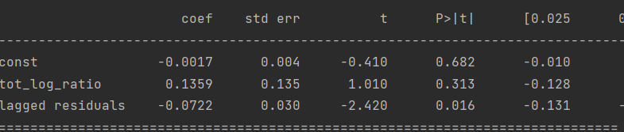
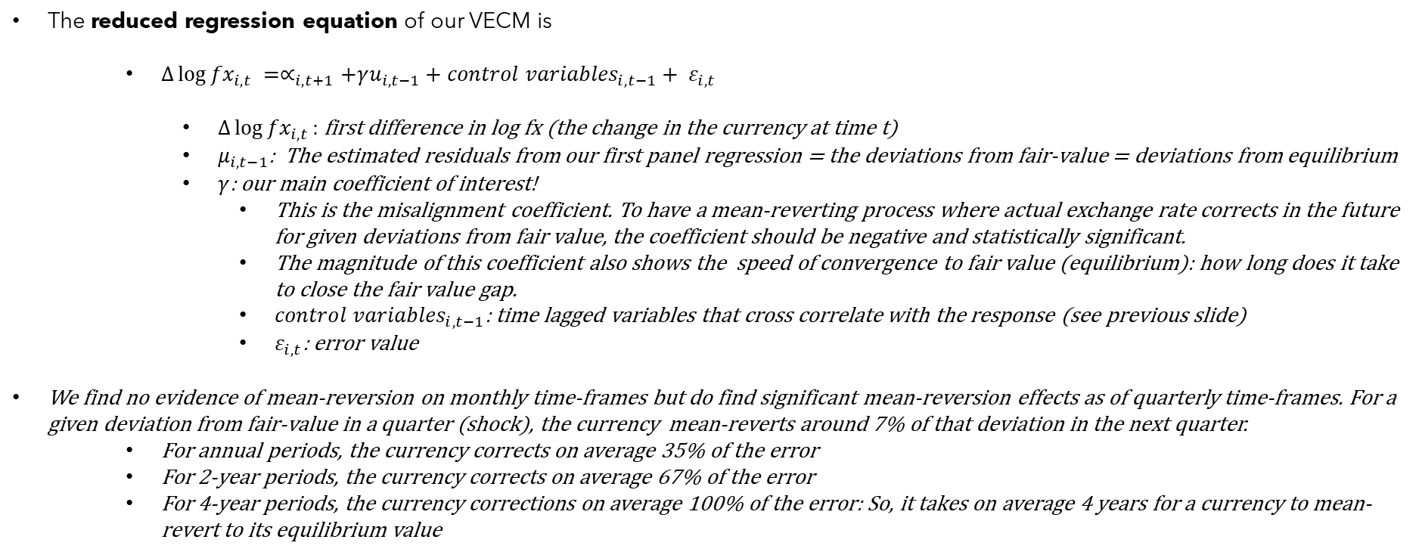
STEP 3 – Vector Error Correction Model
STEP 2 IN-SAMPLE FIXED EFFECT PANEL REGRESSION, STATISTICS
The reduced regression equation of our VECM is
$∆\log{{fx}_{i,t}} =∝_{i,t+1}+γu_{i,t−1}+{control variables}_{i,t−1}+ ε_{i,t}$
$∆\log{{fx}_{i,t}}:$ first difference in log fx (the change in the currency at time t)
$μ_{i,t−1}$: The estimated residuals from our first panel regression = the deviations from fair-value = deviations from equilibrium
$γ$: our main coefficient of interest!
This is the misalignment coefficient. To have a mean-reverting process where actual exchange rate corrects in the future for given deviations from fair value, the coefficient should be negative and statistically significant.
The magnitude of this coefficient also shows the speed of convergence to fair value (equilibrium): how long does it take to close the fair value gap.
${control variables}_{i,t−1}$: time lagged variables that cross correlate with the response (see previous slide)
$ε_{i,t}$: error value
We find no evidence of mean-reversion on monthly time-frames but do find significant mean-reversion effects as of quarterly time-frames. For a given deviation from fair-value in a quarter (shock), the currency mean-reverts around 7% of that deviation in the next quarter.
For annual periods, the currency corrects on average 35% of the error
For 2-year periods, the currency corrects on average 67% of the error
For 4-year periods, the currency corrections on average 100% of the error: So, it takes on average 4 years for a currency to mean-revert to its equilibrium value
Statistics for quarterly change in currency versus lagged residuals (3m) and lagged terms of trade diff (6m), based on panel regression

Slide 20
STEP 4 – Out-of-sample expanding window panel regression
STEP 2 IN-SAMPLE FIXED EFFECT PANEL REGRESSION, STATISTICS
We also perform an expanding window regression where:
Each month – after a warm-up period of 5 years – the coefficients are estimated based on the available data up to that month.
Every month, we calculate a new fair value based on the estimated coefficients.
Next slides contain a visual look of the currency pairs versus their long-term fair value according to the beer-model. The currencies are still expressed as units of dollar for one unit of the domestic currency. So, base currency is always the domestic currency, and the quoted currency is always the dollar. Format is domestic/usd. We quote the currencies that way for ease of interpretation. A high value versus fair value means an overvaluation of the domestic currency (vis-à-vis the dollar) and vice versa. Market conventions can differ. For example: we quote cadusd, but the market normally quotes usdcad. Same for JPY. We quote the currency as jpyusd but the market convention is usdjpy. Etc…
We visualize actual levels, fair-value levels from in-sample regression, fair-value levels from out-of-sample- expanding window regression
The deviation versus fair-value in % (in-sample and out-of-sample).
The deviation versus fair value in z-score (in-sample and out-of-sample, the z-score for out-of-sample contains a new 5-year warmup).

Slide 21
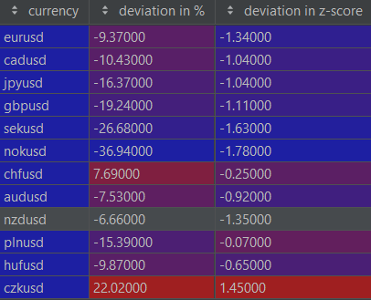
FX LEVELS VERSUS LONG-TERM FAIR VALUE ACCORDING TO BEER-MODEL
Deviations based on out-of-sample expanding window regressions*
Deviations for currencies with quoted currency the USD (not always market convention but easier to interpret the valuations versus fair value) across all currencies.
A positive deviation points to overvaluation versus fair value. A negative deviation points to undervaluation versus fair value. The z-score points to the normalized magnitude (significance) versus history (expanding window again)
Statistic of interest: currencies with large z-scores close to 2
Most overvalued FX:
Dollar: this table clearly illustrates that all currencies seem undervalued versus fair value and should trade higher in equilibrium versus dollar.
CZK
Most undervalued FX
Norwegian Krone (NOK)
Swedish Krone (SEK)
Euro (EUR)
* The in-sample panel regression was ran on the complete panel data set of 12 currencies. Due to techical reasons we performed the expanding window out-of-sample regressions for developed G9 currencies on a panel of only the G9 currencies. For the Eastern European currencies we ran the expanding window regression on a panel of only the 3 Eastern European currencies (HUF, PLN and CZK)

Slide 22
FX LEVELS VERSUS LONG-TERM FAIR VALUE ACCORDING TO BEER-MODEL
Important remark:
Valuation alone should not be the only factor that determines positioning in a currency/fixed income. For Global Macro trading purposes, it is extremely important to add additional analysis by factoring in:
Geopolitical analysis
Momentum & Trend
Sentiment analysis (market positioning, COT,..)
Central bank analysis (expected policy paths, guidance,…)
Carry versus volatility analysis
Fiscal analysis
Sentiment analysis (market positioning, COT,..)
However, currencies with large undervaluation might have the best potential If enough positive catalysts from above are checked off the box. In that regard traders/investors should closely watch NOK, SEK, EUR, NZD for bullish signs.

Slide 23
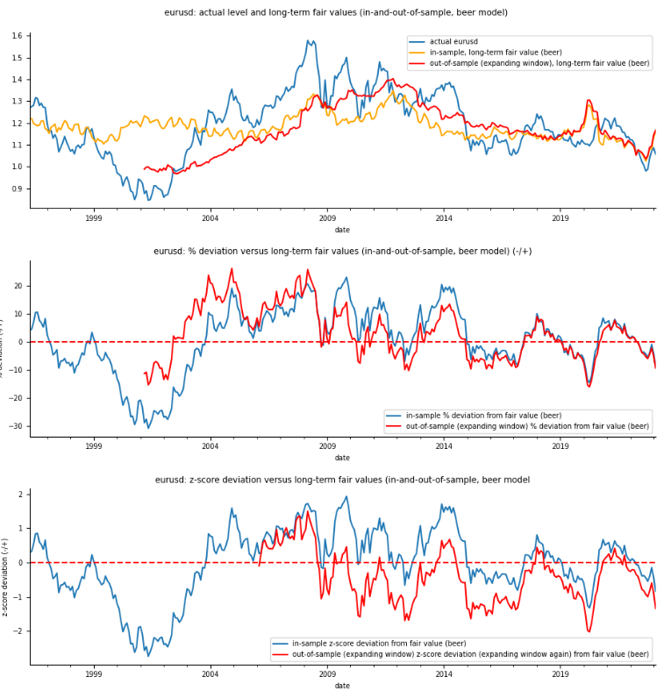
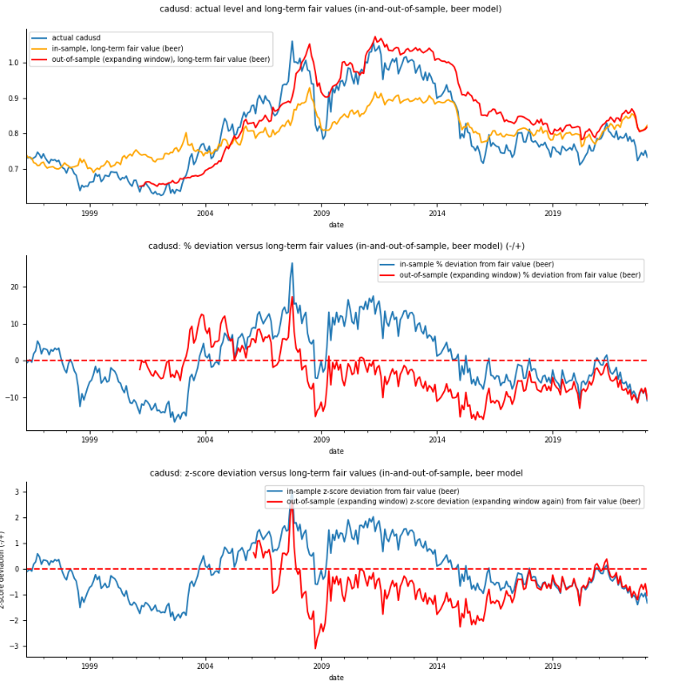
FX LEVELS VERSUS LONG-TERM FAIR VALUE ACCORDING TO BEER-MODEL

Slide 24
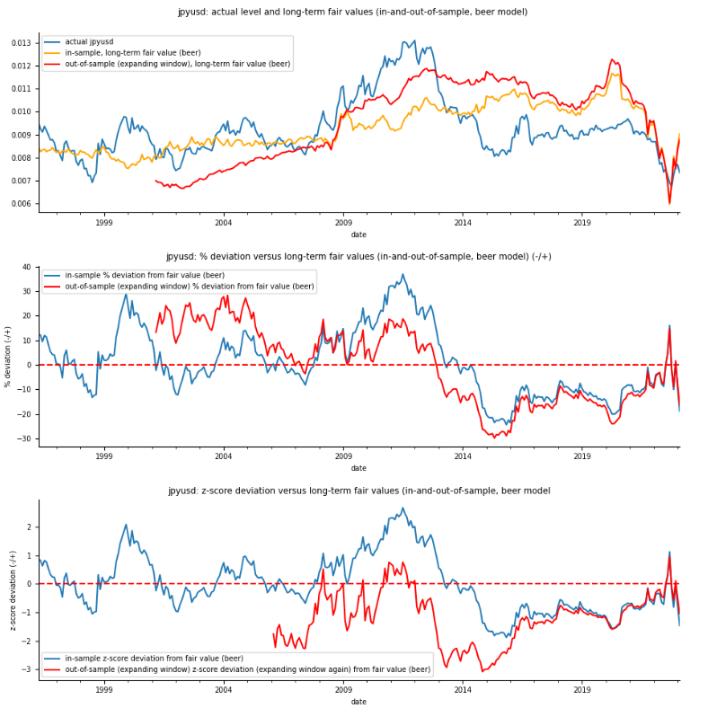
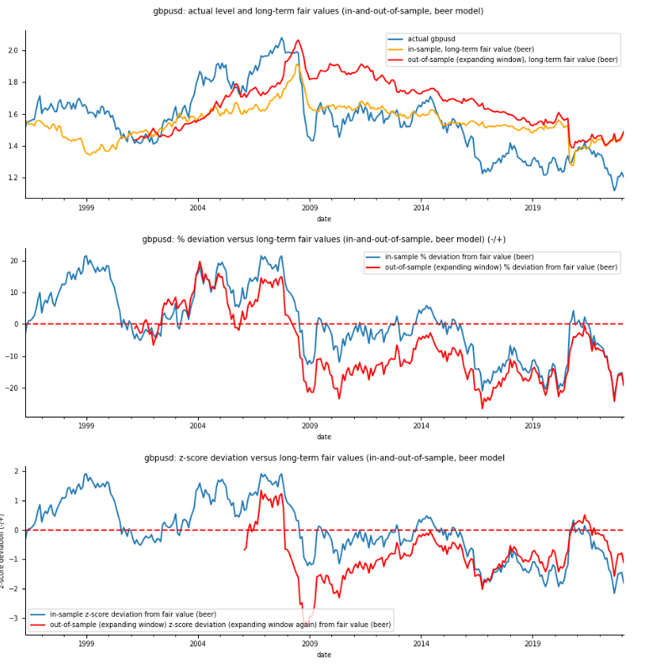
FX LEVELS VERSUS LONG-TERM FAIR VALUE ACCORDING TO BEER-MODEL

Slide 25
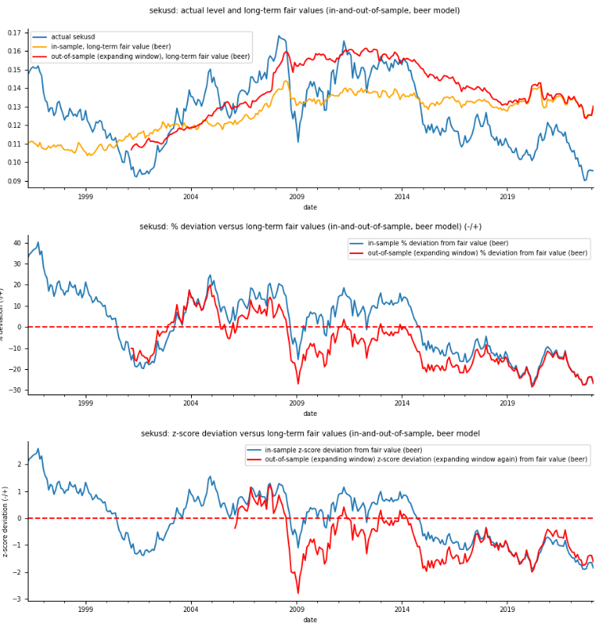
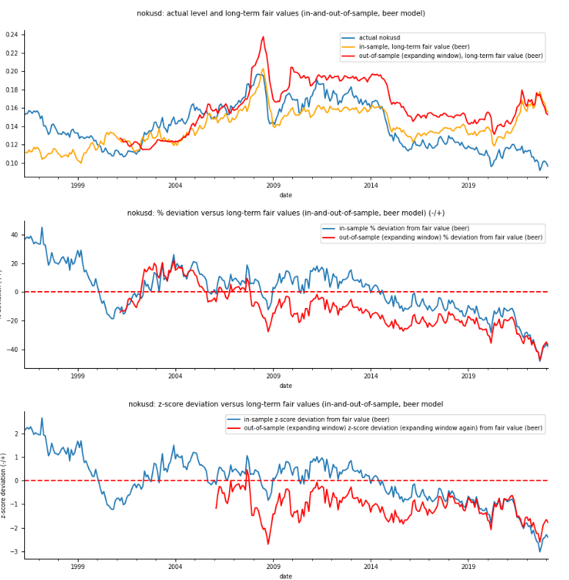
FX LEVELS VERSUS LONG-TERM FAIR VALUE ACCORDING TO BEER-MODEL

Slide 26
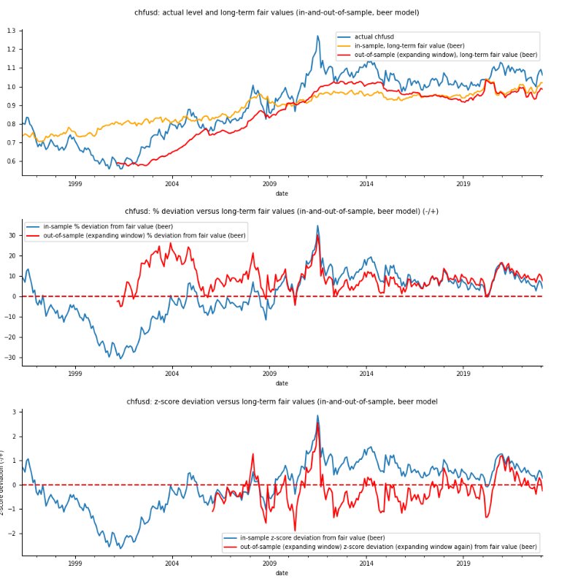
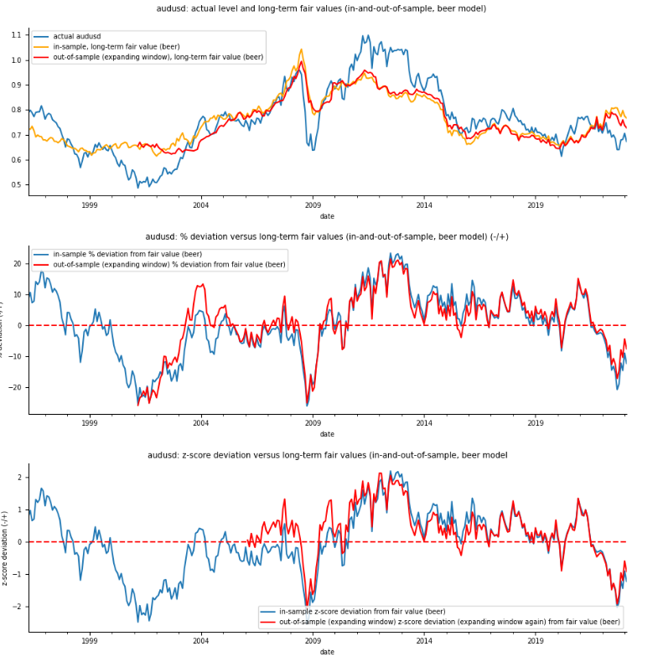
FX LEVELS VERSUS LONG-TERM FAIR VALUE ACCORDING TO BEER-MODEL

Slide 27
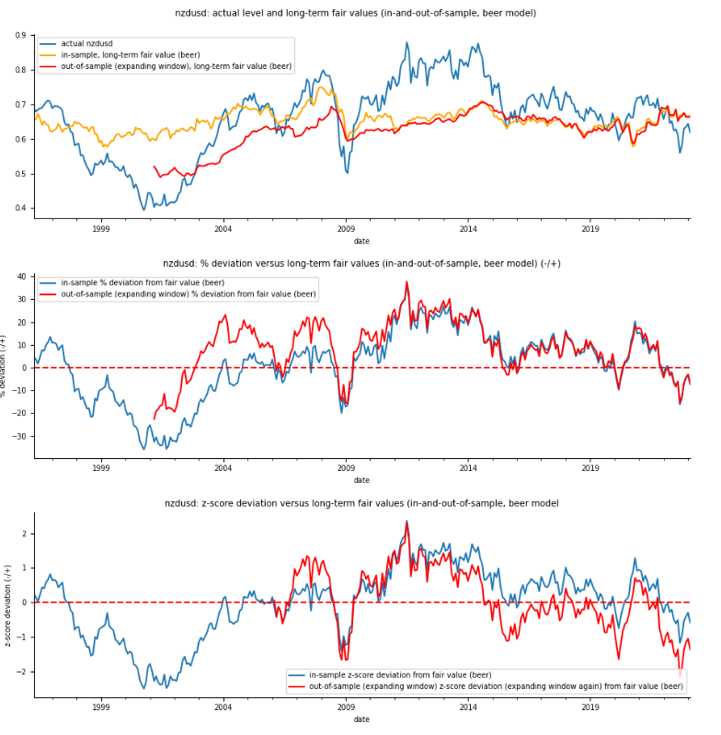
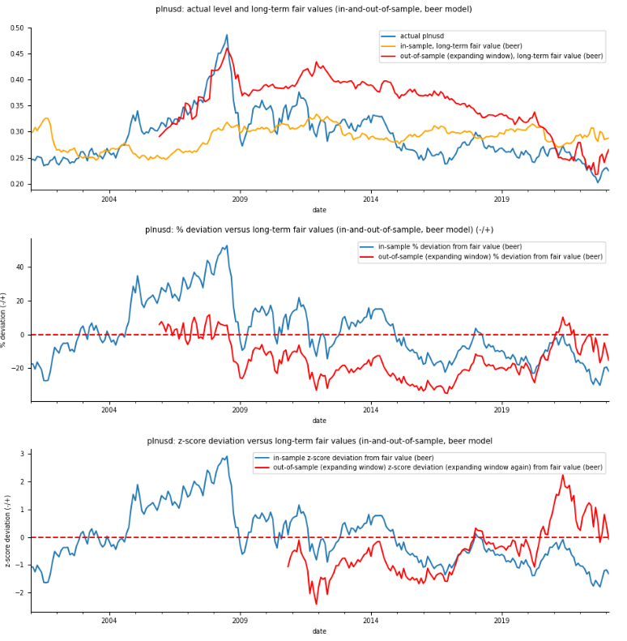
FX LEVELS VERSUS LONG-TERM FAIR VALUE ACCORDING TO BEER-MODEL

Slide 28
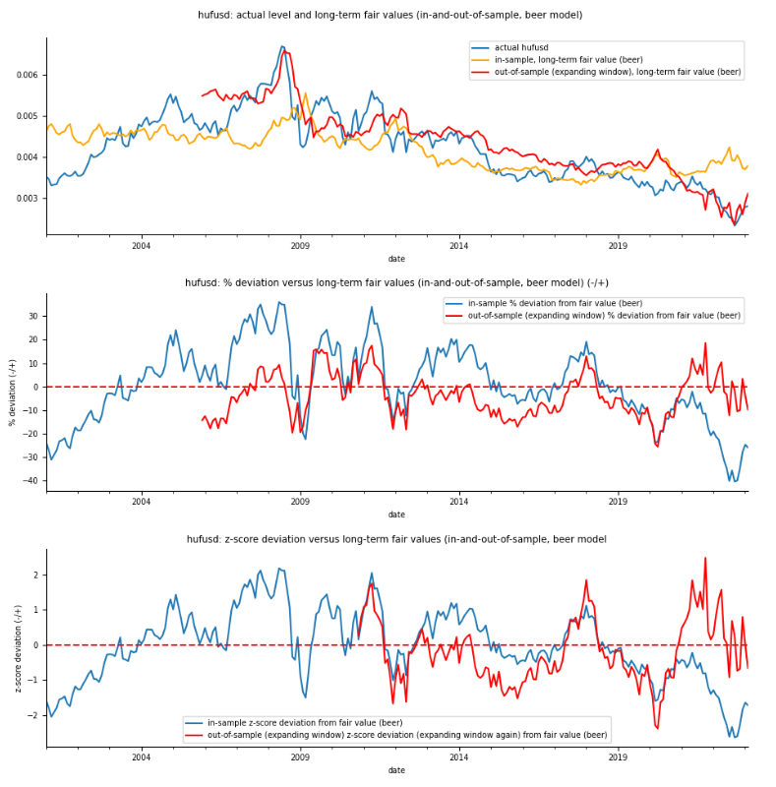
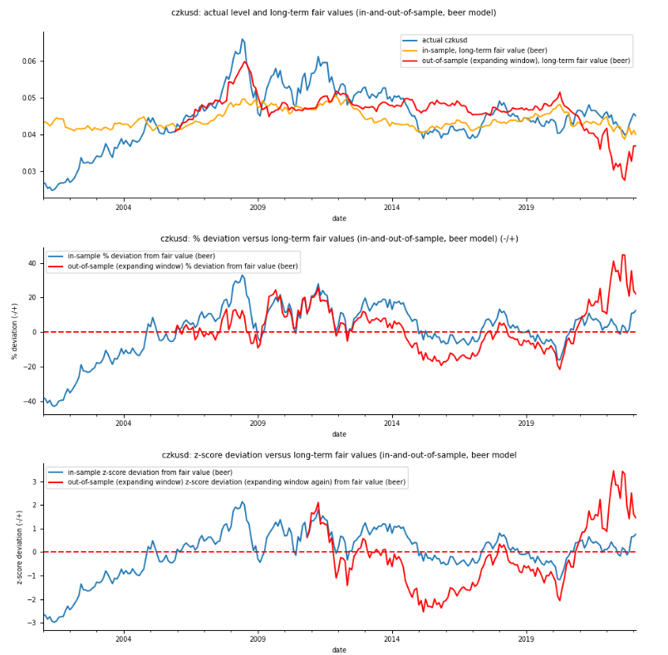
FX LEVELS VERSUS LONG-TERM FAIR VALUE ACCORDING TO BEER-MODEL

